Slide 1


CSE445 / CSE598
Distributed Software Development
Chapter 4
XML and Related Technologies
Lecture 14: XML Basics
Reading: Text Sections 4.1 and 4.2.1

Slide 2
Roadmap
XML Fundamentals
Elements
Attributes
Documents,
Representation
XML Processing
XML Readers, XML Writers, and XPath
XML Type Definition and Validation
Document Type Definition (DTD), XML Schema, and Validation
Case study: HTML 5
XML Style Language and Transformation
XSL, XSLT
Other Web Data Formats and Standards
Lecture 14
Lecture 15
Lecture 16
Lecture 17
Lecture 18

Slide 3
The Role of XML in SOC
XML is used for representing almost all languages, protocols, and data structures in SOC: SOAP, WSDL, UDDI, ebXML, BEPL, OWL, …
Even internal files in .Net are in XML
Configuration files Web.config, which stores application setting, user data, security options, …
XHTML: XML version of html. .Net uses XHTML, instead of html, for the page generated from aspx page. It is a stricter version of html based on XML standard;
DataSet in ADO .Net database management uses XML to represent collection of tables;
…

Slide 4
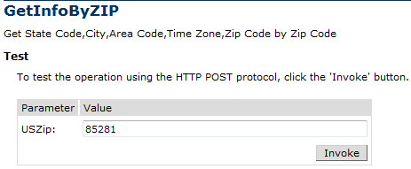
Processing DataSet from Web Services
<?xml version="1.0" encoding="utf-8" ?>
<NewDataSet>
<Table>
<CITY>Tempe</CITY>
<STATE>AZ</STATE>
<ZIP>85281</ZIP>
<AREA_CODE>602</AREA_CODE>
<TIME_ZONE>M</TIME_ZONE>
</Table>
</NewDataSet>

Slide 5
XML Extensible Markup Language
XML is of plain text and with self-describing;
Uses self-defined markup tags surrounding sentences, paragraphs, and even complete documents.
The self-defined tags provide additional information about the data they envelope.
It uses elements and attributes to provide both a logical structure and a physical structure to the document.
XML contains metadata: Data about data.
It is a meta language: a language used for defining other languages

Slide 6
XML Element, Attribute, and Document
An XML document starts with a prolog consisting of a declaration and optional references to external documents (namespaces):
<?xml version="1.0" encoding="UTF-8">
<instructor course=“Service-Oriented Computing"
<name>
<first>John</first>
<last>Doe</last>
</name>
</instructor>
The first line declares that the document follows XML version 1.0 and uses encoding method UTF-8.
The remaining lines contain data, called “elements”, stored in the XML file.

Slide 7
XML Element, Attribute, and Document
Each element is quoted by a pair of tags (opening and closing tags). Tag names are not predefined and can be chosen freely except a few restrictions. A tag must
start with a letter, an underscore, or a colon.
not start with the reserved word xml (case insensitive).
An attribute is a name = "value" equation inside the opening tag of an element.
Attribute
<instructor course="Service-Oriented Computing" officeHours="4">
<title>Professor</title>
<name>
<first>John</first>
<last>Doe</last>
</name>
</instructor>
Element
Content
There is no fixed rule what information should be stored as attributes or as child elements
Child element
Child element

Slide 8
XML Element, Attribute, and Document
There is no fixed rule what information should be stored as child elements or as attributes. However, normally
Elements are used for defining data that are integral to the document. Elements form a rooted tree.
Attributes are used for defining out-of-band data, which give “additional” information. They are stored linearly in the element.
<instructor >
<title degree= “PhD” year = “2001” school = “ASU”>Professor</title>
<name>
<first>John</first>
<last>Doe</last>
</name>
<course level = “Senior”>Service-Oriented Computing</course>
<officeHours>4</officeHours>
</instructor>

Slide 9
XML Syntax: Well-Formed XML Doc
An XML document must be written following certain syntax rules.
Must conform to XML specification at: www.w3.org/TR/REC-xml
There is a unique root element. All other elements are children or descendants of the root element.
Each element is quoted between an opening and a closing tag.
Nested tags are allowed but tags may not overlap. For example, the following is not allowed: <title>Professor<name>Doe</title></name>
Element tag name and content must meet certain restrictions.
Although not required, tag names should be self-describing and depict the true meaning of the content embedded in them.
Tag names need to be “declared” or “defined” in a definition language, e.g., in XML Schema.

Slide 10
Attributes
Attribute values must always be in quotes. Both single and double quotes are valid. Double quotes are most common though.
Attributes are always contained within the opening tag of an element:
<course level = “senior” required = “true”>
Service-Oriented Computing
</course>
Attributes within an element must have unique names: The same attribute name can appear once only within an element. <course level = “senior” level = “graduate”> … <course> is not acceptable
Attributes are more complex to manipulate by program code than elements, as they are not a part of the tree elements

Slide 11
Special XML Empty Element Tag Convention
An empty element is an element without content or child elements:
<myElement></myElement>
which can be represented with a single tag of the form
<myElement />
Why do we need empty elements?
It can still have attributes:
<photo image =“myPhoto.jpeg” />
which is a short hand notation of
<photo image =“myPhoto.jpeg”> </photo>

Slide 12
XML Document Can be Visually Represented as a Rooted Tree
Empty element contains attribute only
An element contains child elements
Elements contain child elements
instructor
title
name
photo
course
officeHours
image=
“myPhoto.jpeg”
level1=
“senior”
level2=
“grad”
first
last
Programming
Languages
Professor
John
Doe
4
Elements contain text content
Text Content
Attribute

Slide 13
Representing Special Characters in Text Content
Five characters are reserved for markup purpose. The parsers need to differentiate them from the text content characters.
character Entity name Meaning
< lt less than
> gt greater than
& amp ampersand
' apos apostrophe, e.g., computer's keyboard
" quot quotation
Two ways to differentiate them:
Use Entity Reference for these characters
For example, to represent 0 < x < 100, you can use:
<Range> 0 &lt; x &lt; 100</Range>
What happen if your post in the course discussion board has characters < and >?
Use Character Reference (ASCII code) for these characters
For example,
<Range> 0 &#60; x &#60; 100</Range>

Slide 14
Character and Parsed Character Data
If a piece of text has many markup characters, the reference method makes the text not readable.
<myCode>
function AND(a, b) {
if (a == “true” && b == “true”) then
{ return “true” }
else
{ return “false” }
}
</myCode>
Using Entity Reference for the special characters
<myCode>
function AND(a, b) {
if (a == &quot;true&quot; &amp;&amp; b == &quot;true&quot;) then
{ return &quot;true&quot; }
else
{ return &quot;false&quot; }
}
</myCode>

Slide 15
Using Character and Parsed Character Data
XML parsers differentiate two types of textual data:
CDATA - Character Data: Data that appears between the pair: <![CDATA[ and ]]> tags
PCDATA - Parsed Character Data: Any data that are not in CDATA tags.
Using CDATA for text with many markup characters is more readable:
<myCode>
<![CDATA[
function AND(a, b) {
if (a == “true” && b == “true”) then
{ return “true” }
else
{ return “false” }
}
]]>
</myCode>

Slide 16
Representing Special Characters in CDATA
XML parsers will ignore (not do syntax checking) on CDATA but parse PCDATA — that is, interpret it as a part of the markup language.
The practical implication is that for data between the tags <![CDATA[ and ]]>, we do not have to conform to the syntax of XML.
Outside the tags <![CDATA[ and ]]>, we must conform to the syntax of XML.

Slide 17
Whitespace in XML
XML defines four characters to be whitespace
Character | Unicode Value
tab | #x9
newline | #xA
carriage return | #xD
space | #x20
Why would whitespace be handled differently from other characters?

Slide 18
Collapsing (normalizing) or Preserving
To be discussed later
Normalization: Remove additional whitespaces
Preserving: Keep all whitespaces
Declaration in XML Document Type Definition (DTD)
<!DOCTYPE instructor [
<!ATTRIBUTE code xml:space #FIXED “preserve”>
<!EMEMENT name (first, middle?, last)>
<!EMEMENT first (#PCDATA)>
<!EMEMENT last (#PCDATA)>
<!EMEMENT course (#PCDATA)>
<!EMEMENT officeHours (#PCDATA)>
]>
If use “default”
Whitespaces will be collapsed!

Slide 19
Comments
<?xml version="1.0" encoding="UTF-8">
<myCode>
<!-- This function performs logic AND operation.
It takes two boolean variable as input
-->
function AND(a, b) {
if (a == &quot;true&quot; &amp;&amp; b == &quot;true&quot;) then
{ return &quot;true&quot; }
else
{ return &quot;false&quot; }
}
</myCode>

Slide 20
Namespaces
Namespaces provide a mechanism for qualifying (scoping) element and attribute names to avoid naming collisions.
In C++, we can use the namespace prefixes (scope resolution operator) to qualify its elements so that the elements won’t clash if used in the same document with other elements having the same names but different definitions.
<?xml version="1.0"?>
<cse:Courses
xmlns:cse="http://scidse.asu.edu/courses/cse.php"
xmlns:asu=“http://www.asu.edu/it/tempe/classrooms/"
<cse:Course>
<cse:Name>Distributed Software Development</cse:Name>
<cse:Code >CSE445</cse:Code>
<cse:Level>Senior</cse:Level>
<asu:Room asu:Image=“layout210.jpeg” >BYAC210</asu:Room>
<cse:Cap>40</cse:Cap>
</cse:Course>
XML namespace

Slide 21
Namespaces
…
<cse:Course>
<cse:Name>Introduction to Programming Languages</cse:Name>
<cse:Code >CSE240</cse:Code>
<cse:Level>Sophomore</cse:Level>
<asu:Room asu:Image=“layout110.jpeg”>BYAC110</asu:Room>
<cse:Cap>82</cse:Cap>
</cse:Course>
</cse:Courses>
Note, an element’s attributes are not automatically scoped to a namespace. In the following example, the Image attribute doesn’t belong to a namespace:
<asu:Room Image=“layout110.jpeg”></asu:Room>
However, you can use namespace prefixes to join attributes to namespaces:
<asu:Room asu:Image=“layout110.jpeg”></asu:Room>

Slide 22
Roadmap
XML Fundamentals
Elements, Attributes, and Documents, representation
XML Processing
XML Readers
XML Writers
XPath
XML Type Definition and Validation
Document Type Definition (DTD)
XML Schema
Validation
XML Style Language and Transformation
XSL, XSLT
Google Data Representation and Management

Slide 23
XML Related Technologies
HTML
XHTML
XAML
Document
Type Definition
DTD
Schema
XML Parser
XML Query
Language
XPath
XQL
SOAP
WSDL
UDDI/ebXML
OWL
BPEL
XML-based
Protocols and Languages
XML
XSL
XSLT
XML Style and
Transformation
C#
Java
DOM
SAX
Processing
XML Parsers

Slide 24
XML Parsers
There are three types of parsers for extracting data from XML
DOM: Document Object Model
www.w3.org/TR/DOM-level-2-core
Read the entire document into the memory for random access -- problem: if the doc is huge.
Java DOM Parser: http://www.jdom.org/
MSXML: free MS parser that supports DOM, as well as SAX
SAX: Simple (Stream) API for XML
www.saxproject.org
Not a w3 standard
Event-based API, read the document in a stream
Developed by the Java community, and supported in all environments
XPath

Slide 25
XML Classes in .Net
The .Net FCL’s System.Xml namespace offers a variety of classes for reading and writing XML documents.
The XmlDocument class is similar to MSXML, but is simpler to use.
If you prefer a stream-based approach (SAX), you can use XmlTextReader or the schema-aware XmlvalidatingReader, instead.
A complementary class named XmlTextWriter allows you to create XML documents from scratch.

Slide 26
The XmlDocument Class in .Net
XmlNode class is the base class in .Net’s implementation of the DOM.
Each node of a DOM tree is an instance of XmlNode class, which exposes methods and properties for navigating a DOM tree, e.g., reading and writing node content, adding and removing nodes.
XmlDocument derives (inherits) from XmlNode and adds methods and properties of its own, supporting loading and saving of documents, the creation of new nodes, and other operations.
XmlDocument provides a programmatic interface to XML documents that complies with the DOM specification.
It represents a document as an upside-down rooted tree of nodes, with the root element, or document element, at the top.

Slide 27
DOM Representation of a Simple XML Doc
http://neptune.fulton.ad.asu.edu/WSRepository/xml/Courses.xml
Courses.xml
Courses
Course
…
Element
names
Name
Code
Level
Room
Cap
attribute
Distributed Software Development
CSE445
Senior
BYAC270
40
Element
content
Short =“Distr Soft Dev”

Slide 28
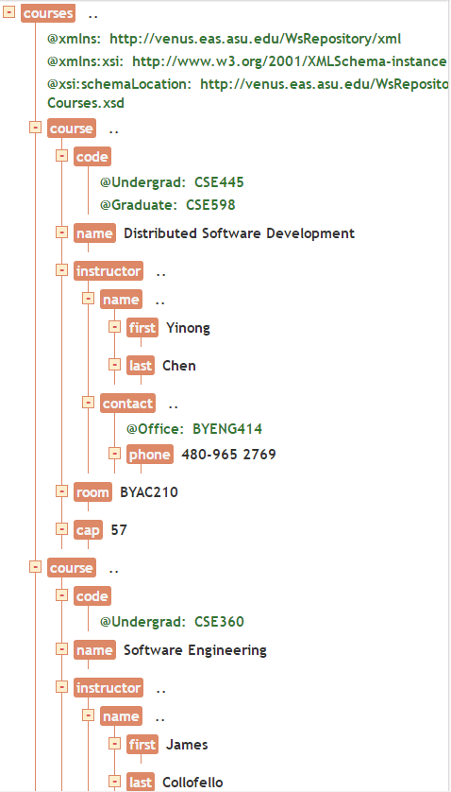
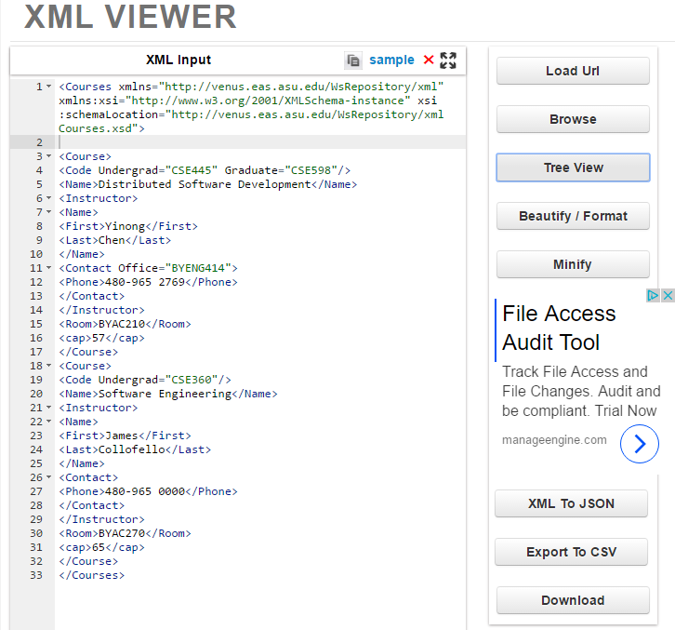
Online XML Viewer: http://codebeautify.org/xmlviewer

Slide 29
Using XmlDocument to load a Doc
The following statements create an XmlDocument object and initialize it with the contents of Courses.xml:
XmlDocument xd = new XmlDocument (); //create an object
xd.Load (“Courses.xml”); // call Load method
The method Load parsers the file “Courses.xml” and builds an in-memory tree representation.
It throws an XmlException if the document isn’t well-formed -- Doing the validation while reading.

Slide 30
Load a Doc from a Remote Site
The following statements create an XmlDocument object and initialize it with the contents of Courses.xml:
Code embedded in Web page
<%@ Page language=C# debug=“true” %>
<%@ Import Namespace=“System.Xml” %>
<SCRIPT runat=“server”>
void Page_Load(Object Sender, EventArgs e)
{
XmlDocument xd = new XmlDocument();
xd.Load(“http://neptune.fulton.ad.asu.edu/WSRepository/xml/Courses.xml”);
this.Label.Text = xd.FirstChild.Name;
}
</SCRIPT>

Slide 31
Reading XML Doc and Write to Screen
void OutputNode (XmlNode node) // recursive
{
If (node == null) exit;
Console.WriteLine (“Type={0}\tName={1}\tValue={2}”,
node.NodeType, node.Name, node.Value);
if (node.HasChildNodes)
{
XmlNodeList children = node.ChildNodes;
foreach (XmlNode child in children)
OutputNode (child);
}
}
// Is it tail-recursive?
// What traversing order is used?

Slide 32
Pre-Order Tree Traversing Algorithms
preorderTraverse(p)
if p ≠ null then
print(p.data);
for each child node preorderTraverse(p.nextChild);
p
root
10
8
16
inorderTraverse(p)
if p ≠ 0 then
inorderTraverse(p.left);
print(p.data);
inorderTraverse(p.right);
5
15
17
2
7
9
12
13
14
postorderTraverse(p)
if p ≠ 0 then
for each child node
postorderTraverse(p.nextChild); print(p.data);

Slide 33
Processing Data Set from Web Services
<?xml version="1.0" encoding="utf-8" ?>
<NewDataSet>
<NAME>City Info</NAME>
<Table>
<CITY>Tempe</CITY>
<STATE>AZ</STATE>
<ZIP>85281</ZIP>
<AREA_CODE>602</AREA_CODE>
<TIME_ZONE>M</TIME_ZONE>
</Table>
</NewDataSet>
preorder
postorder
postorder
City Info
Tempe
AZ
85281
602
M
M
602
85281
AZ
Tempe
City Info
Tempe
AZ
85281
602
M
City Info
or

Slide 34
.Net Classes Defined in System.Xml Namespace
XmlAttribute | Represents an attribute, with methods dealing with attributes.
XmlDocument | Represents an XML document, dealing with the overall doc.
XmlDocumentType | Represents the document type declaration.
XmlElement | Represents an element.
XmlLinkedNode | Deals with nodes immediately preceding or following this node.
XmlNamedNodeMap | Represents a collection of nodes that can be accessed by name or index.
XmlNode | Represents a single node in the XML document.
XmlNodeList | Represents an ordered collection of nodes.
XmlReader | Represents a reader that provides fast, non-cached, forward-only access to XML data.

Slide 35
Using Classes and Methods in System.Xml Namespace
System.XmlDocument
.SelectSingleNode()
System.XmlNode
.ChildNodes()
.Attributes()
System.XmlNodeList
System.XmlNamedNodeMap
.Node()
.Node()
Obtain a collection of nodes that can be accessed by name or index

Slide 36
Methods in XmlDocument Class
Attributes | Gets an XmlAttributeCollection containing the attributes of this node (inherited from XmlNode)
BaseURI | Overridden. Gets the base URI of the current node.
ChildNodes | Gets all the child nodes of the node (inherited from XmlNode)
DocumentElement | Gets the root XmlElement for the document.
DocumentType | Gets the node containing the DOCTYPE declaration.
FirstChild | Gets the first child of the node (inherited from XmlNode)
HasChildNodes | Gets a value indicating whether this node has any child nodes (inherited from XmlNode)
IsReadOnly | Overridden. Gets a value indicating whether the current node is read-only.
Item | Overloaded. Gets the specified child element (inherited from XmlNode)

Slide 37
Member Functions in XmlDocument Class (contd.)
LastChild | Gets the last child of the node (inherited from XmlNode)
NextSibling | Gets the node immediately following this node (inherited from XmlNode)
NodeType | Overridden. Gets the type of the current node.
ParentNode | Overridden. Gets the parent node of this node (for nodes that can have parents).
Prefix | Gets or sets the namespace prefix of this node (inherited from XmlNode)
PreserveWhitespace | Gets or sets a value indicating whether to preserve white space in element content.
PreviousSibling | Gets the node immediately preceding this node (inherited from XmlNode)
Schemas | Gets or sets the XmlSchemaSet object associated with this XmlDocument.
Value | Gets or sets the value of the node (inherited from XmlNode)

Slide 38
XmlNodeType Enumeration
XmlNodeType Example
Attribute <Course image=“My445.jpeg”>
CDATA <![CDATA[“This is character data”]]>
Comment <!-- This is a comment -->
Document <Courses>
Document Type <!DOCTYPE Courses SYSTEM “Courses.dtd”>
Element <Course>
Entity <!ENTITY filename “Courses.xml”>
EntityReference &lt;
Notation <!NOTATION GIF89a SYSTEM “gif”>
Processinglnstruction <?xml-stylesheet type=“text/xsl” href=“Courses.xsl”?>
Text <Code>CSE445</Code>
Whitespace <Name/>\r\n<Name/>
XmlDeclaration <?xml version=“1.0”?>

